Slide 1
Jenkins Jobs

Slide 2
Parameterized Build
A build parameter allows us to pass data into our Jenkins jobs. Using build parameters, we can pass any data we want git branch name, secret credentials, hostnames and ports, and so on.
Any Jenkins job or pipeline can be parameterized. All we have to do is check the box on the General settings tab that says This project is parameterized:
Sometimes, it is useful/necessary to have your builds take several "parameters." Consider the following use case:
You set up a test job on Jenkins, and it accepts a distribution bundle as a parameter and perform tests against it. You want to have developers do local builds and let them submit builds for test execution on Jenkins. In such a case, your parameter is a zip file that contains a distribution.
Your test suite takes so much time to run that in normal execution you can't afford to run the entire test cycle. So you want to control the portion of the test to be executed. In such a case, your parameter is perhaps a string token that indicates that test suite to be run.
The parameters are available as environment variables. So e.g., a shell ($FOO, %FOO%) or Ant ( ${env.FOO} ) can access these values.

Slide 3
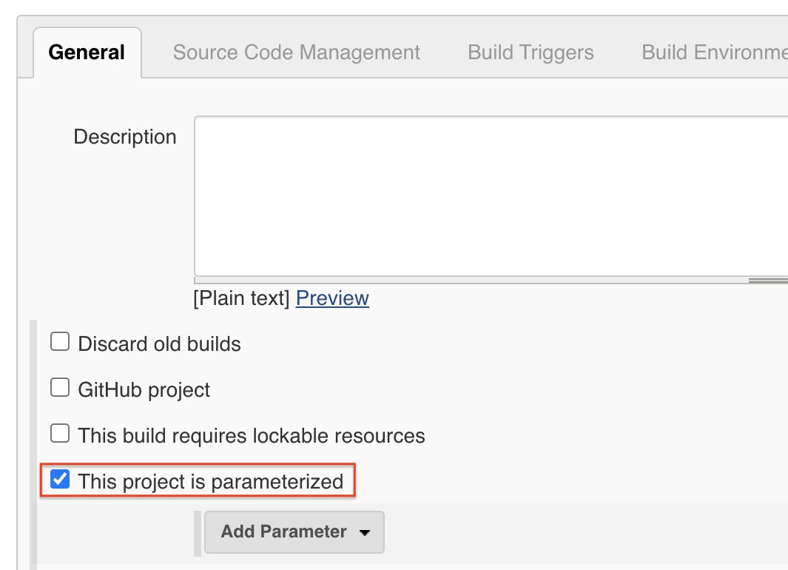
Defining Build Parameters
A build parameter allows us to pass data into our Jenkins jobs. Using build parameters, we can pass any data we want git branch name, secret credentials, hostnames and ports, and so on.
Any Jenkins job or pipeline can be parameterized. All we must do is check the box on the General settings tab that says This project is parameterized:
Then we click the Add Parameter button. From here, we must specify several pieces of information:
Type: the data type for the parameter (string, boolean, etc.)
Name: the name by which the parameter will be identified
Default value: an optional value that will be used when a user does not specify one
Description: optional text that describes how the parameter is used
A single Jenkins job or pipeline can have multiple parameters. The only restriction is the parameter name must be unique.

Slide 4
Types of Parameters
Jenkins supports several parameter types. Below is a list of the most common ones, but keep in mind that different plugins may add new parameter types:
String: any combination of characters and numbers
Choice: a pre-defined set of strings from which a user can pick a value
Credentials: a pre-defined Jenkins credential
File: the full path to a file on the filesystem
Multi-line String: same as String, but allows newline characters
Password: like the Credentials type, but allows us to pass a plain text parameter specific to the job or pipeline
Run: an absolute URL to a single run of another job

Slide 5

Using Build Parameters
Traditional Jobs
With a traditional Jenkins job, we define one or more build steps. The most common build step is executing a shell script or Windows batch commands.
Let's say we have a build parameter named packageType. Inside a shell script, we can access build parameters just like any other environment variable using the shell syntax:
${packageType}
And with batch commands, we use the native Windows syntax:
%packageType%
We can also create build steps that execute Gradle tasks or Maven goals. Both step types can access build parameters just like they would any other environment variable.

Slide 6
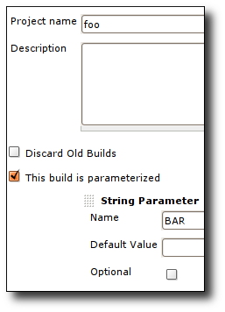
Defining Parameters
First, you need to define parameters for your job by selecting "This build is parameterized", then using the drop-down button to add as many parameters as you need.
There are different parameter types available, and it is extensible, too. The way parameters take effect is also different depending on the parameter type you choose.

